Slide 1

HE IS WORTHY
Great Love Junior Academy · Mayuge District, Uganda

Slide 2
JULY 2020
A man I had never met sent me
a friend request on Facebook.

Slide 3
MAY 2024
Isaac asked for help.
I told him I was not comfortable
starting a GoFundMe.
“What are your needs?”

Slide 4
100
orphans.

Slide 5
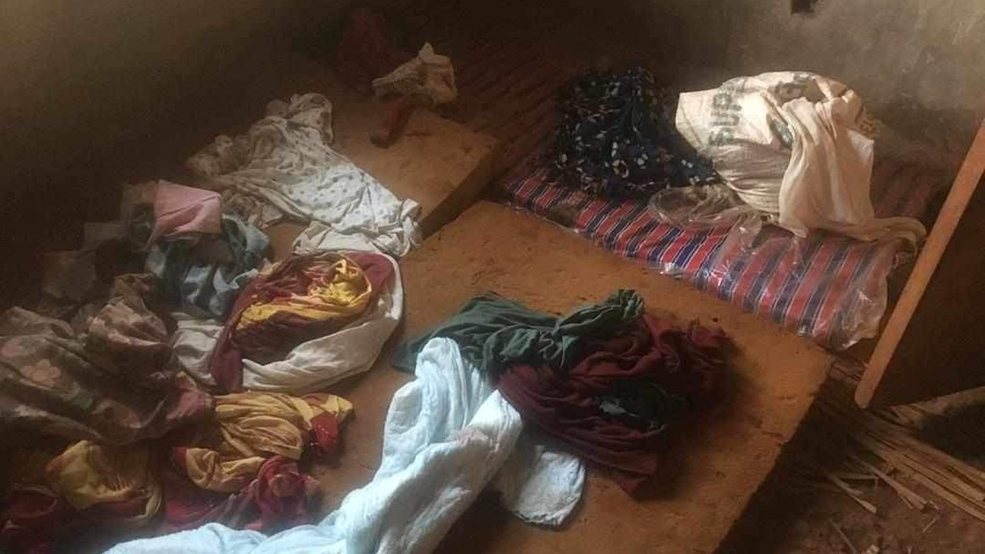
He sent me a picture of what they were sleeping on.
He was caring for them out of his salary.
He needed mattresses and beds.

Slide 6
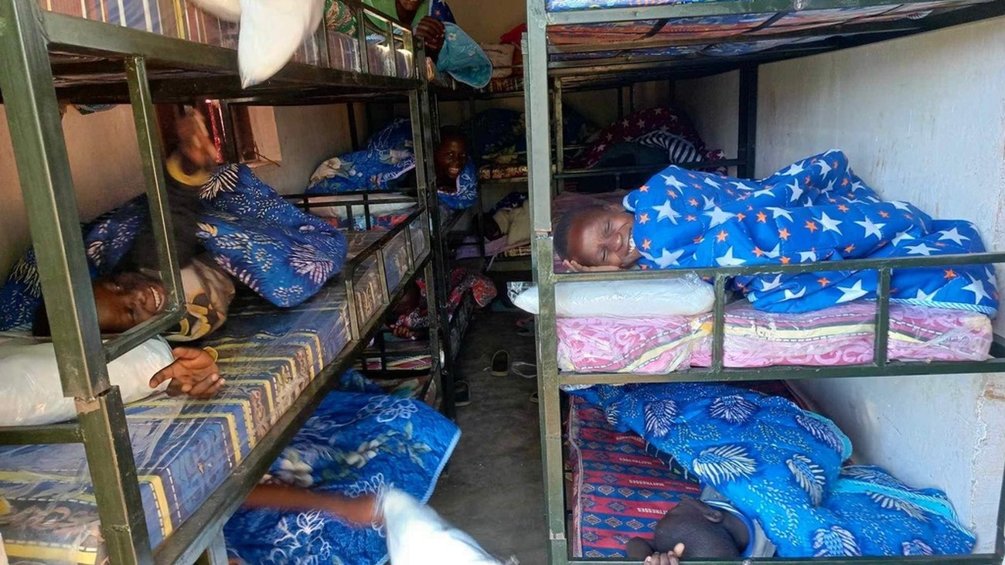
Vicki and I prayed and decided to send him money for:
mattresses
beds
blankets
mosquito nets

Slide 7
2018
Then he wrote to me about what the kids were asking him.
“But Isaac, if Jesus loves us,
why do we sleep angry,
why all my parents are lepers
and many are dead because of no treatment,
have no school fees always,
but your telling Jesus loves all.”
the children, in Isaac’s words

Slide 8
He had no answer.
“The truth just realised
tears coming out of my eyes
because it was seeing life
hard and hopeless.”
Pastor Isaac Muwewesi
All they had was faith and prayers.

Slide 9
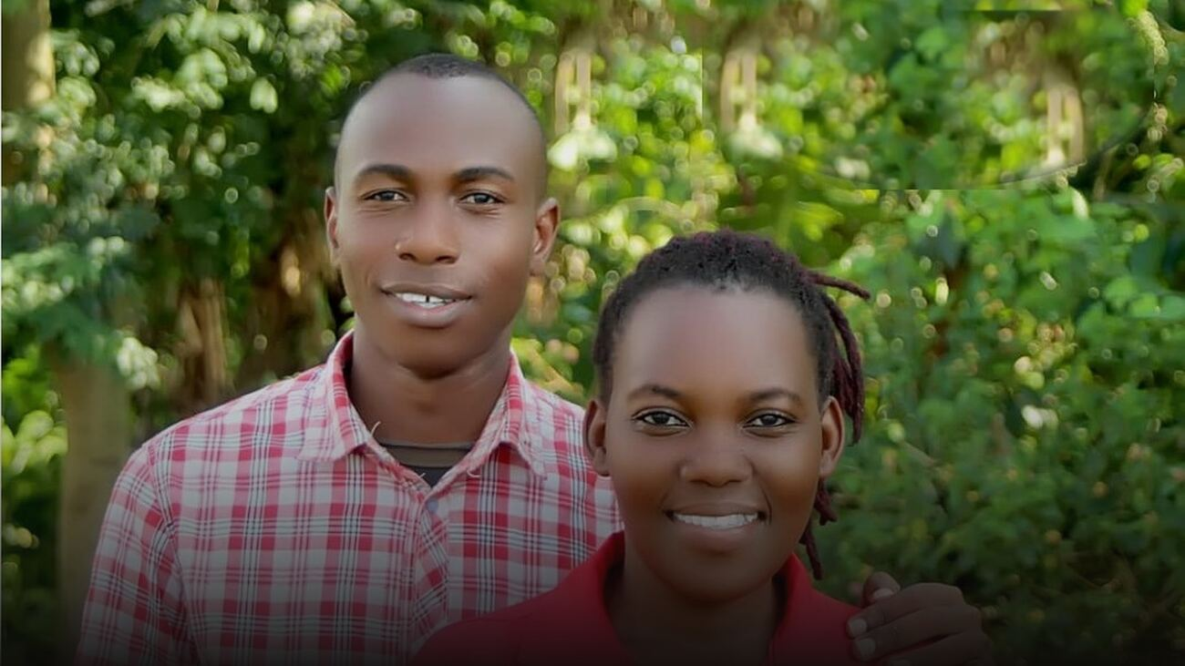
Isaac, 33.
A pastor, and the sales
manager of a motorcycle
shop in Jinja.

Slide 10
We decided to hire teachers and rent a school in November 2024.
The school building we found available for rent was Royal Park Primary School.
It had failed because the families in the villages around it could not afford the fees.

Slide 11
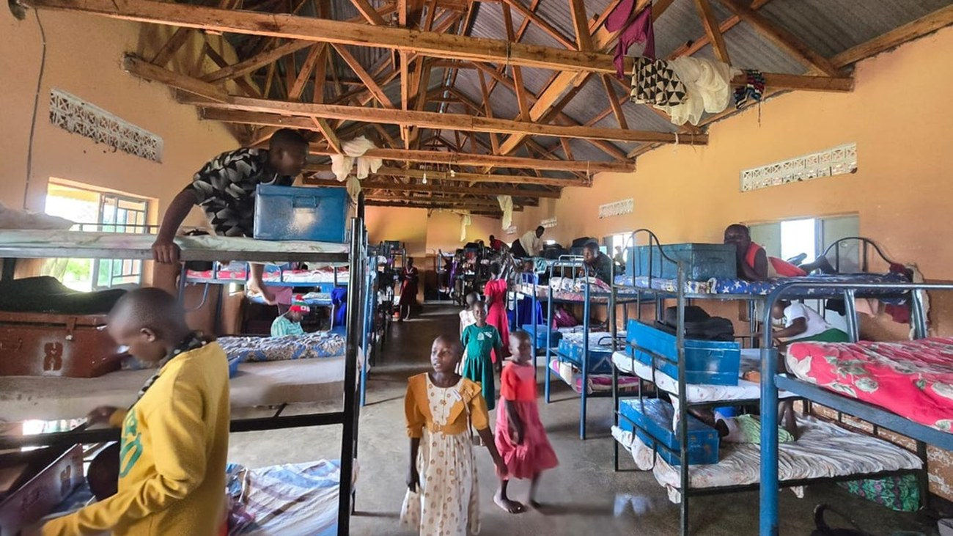
At Great Love Junior Academy, every child
living in the single dormitory building
now has a bed and a foot locker for
their personal use.

Slide 12
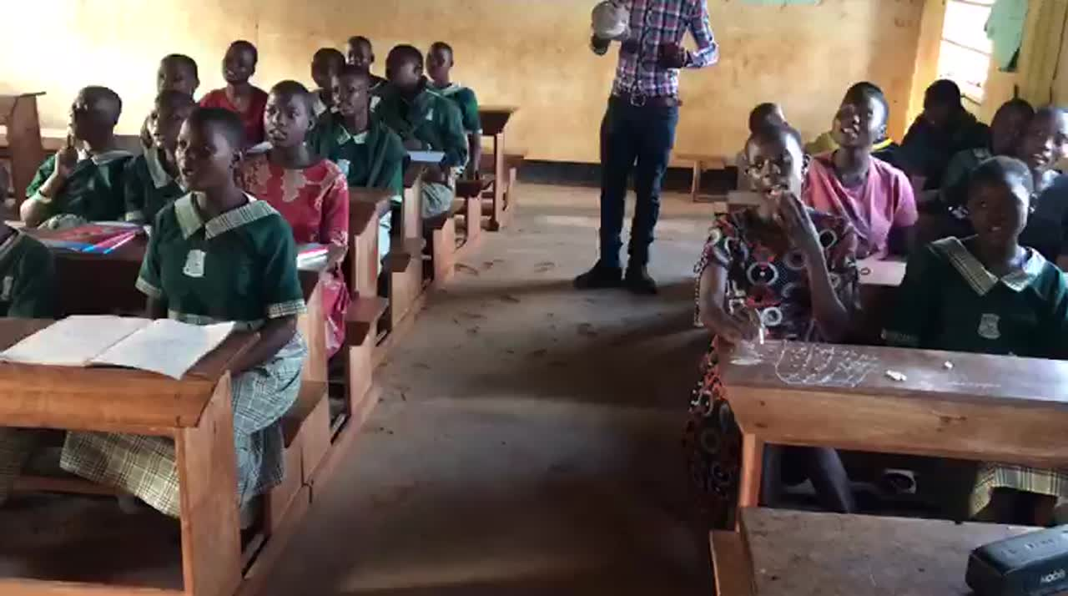
We Started a Choir
I am Adopted; I’m a child of the King.
God is my Father, and he owns everything.
He walks beside me; He's my very best friend.
Praise God, I'll never be lonely again.
Chorus:
I am adopted, hallelujah! I've got a new song.
I am adopted, hallelujah! I finally belong.
I've got a brand new family overflowing with love.
I’m a child of my Father above.
My Father chose me, and He loves me, I know.
He will be with me wherever I go.
I'll never worry; I have joined royalty.
I am a member of the King's family.
Chorus:
I’m adopted, hallelujah! I've got a new song.
I’m adopted, hallelujah! I finally belong.
I've got a brand new family overflowing with love.
I'm a child of my Father above.
I've got a brand new family overflowing with love.
I'm a child of my Father above.
I’m a child of my father above
I’m adopted, hallelujah, I belong!
“I Am Adopted, a Child of the King” · Majesty Music · majestymusic.com
These are all orphans — singing about being adopted.
Notes:
The panel on the right is empty on purpose — click it, delete the grey placeholder line, and type or paste the words in. Cambria 15pt is already set, so it will match the deck. If you decide against the words, tell Claude and slide 12 goes back to the full-width film in one move.
Before you advance to this slide, say the title out loud: "listen to what they're singing." Then step back and say nothing. It starts itself at full volume and moves on by itself when it ends.

Slide 13
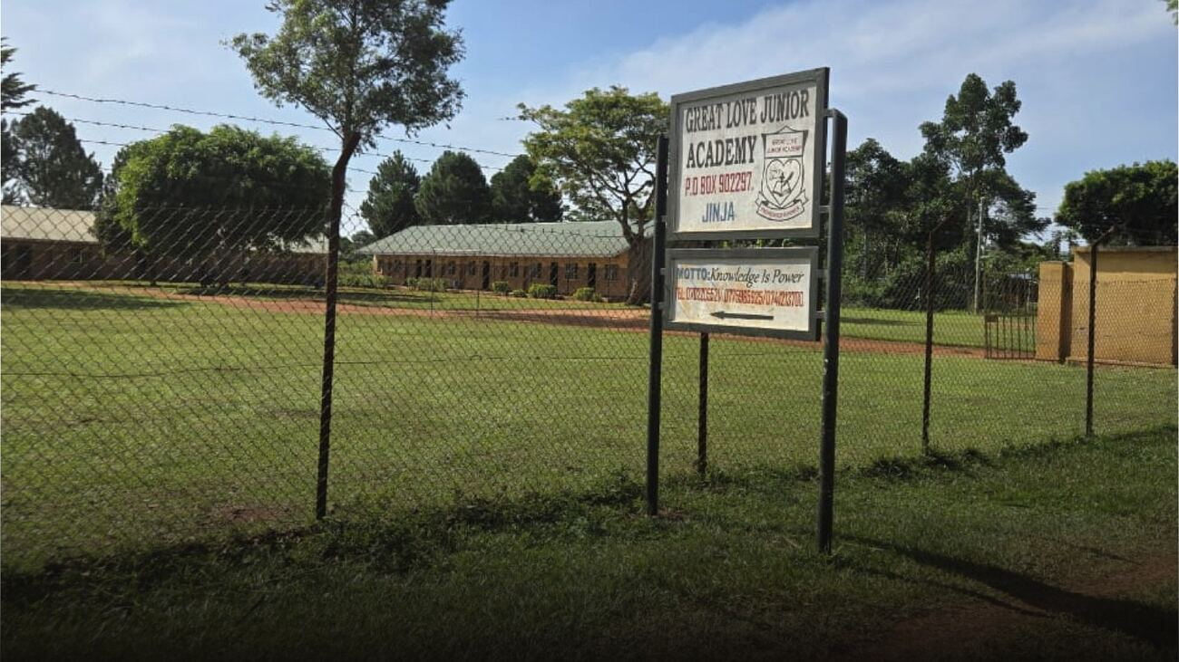
We stopped renting.
Bought May 2026 · $77,800
4.2 acres at Kauma. Surveyed, titled, ours. What we build now, we keep.

Slide 14
In two years
100
150
494
140
38
orphans in May 2024,
when Isaac first wrote
orphans and scholarship
children we support
enrolled today at
Great Love Junior Academy
living at the school,
three meals a day
still waiting
for a sponsor
School roll, September 2026 · Baby Class to P7

Slide 15
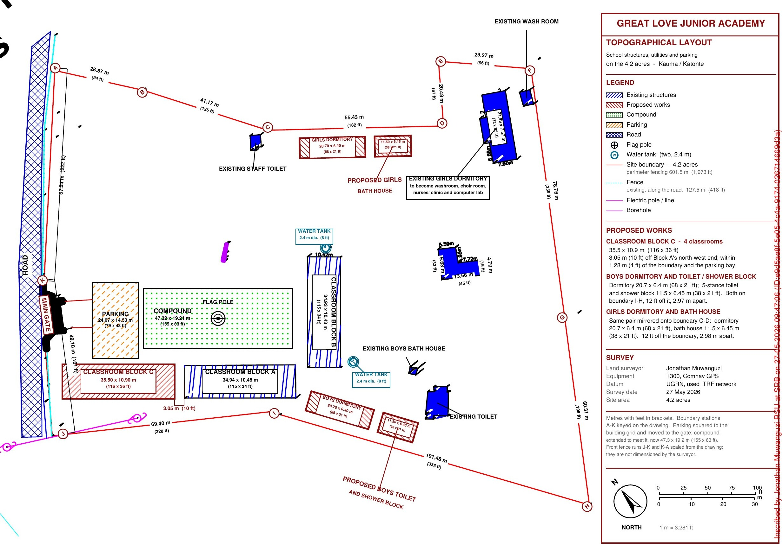
The building program
PLAN FOR 2026
• Lightning arrestors $1,100
• City water to the site $500
• Perimeter fence, 1,970 ft $12,253
• Four-classroom block $20,000
PLAN FOR 2027
• 1 Girls’ dormitory $20,000
• 2 Girls’ toilet and washroom $15,000
• 3 Boys’ dormitory $20,000
• 4 Boys’ toilet and washroom $15,000
• 5 Old dormitory remodel $10,000
Six phases
Building costs are current estimates from the team in Uganda. The classroom block already has $10,000 in hand.

Slide 16
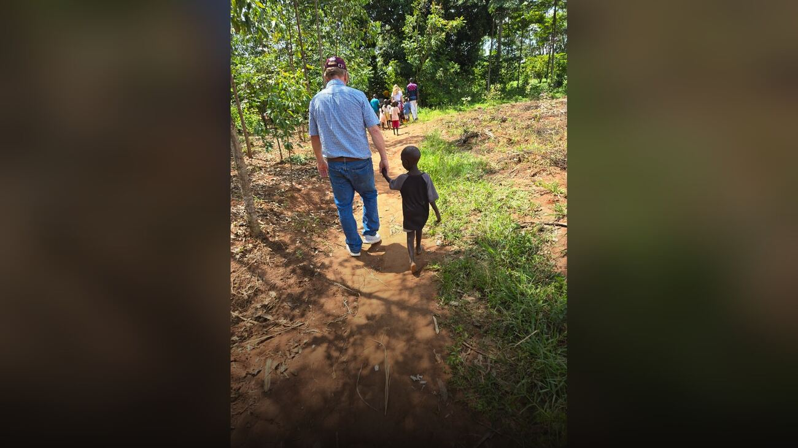
The Walk
FEBRUARY 2026
We went to see for ourselves.

Slide 17
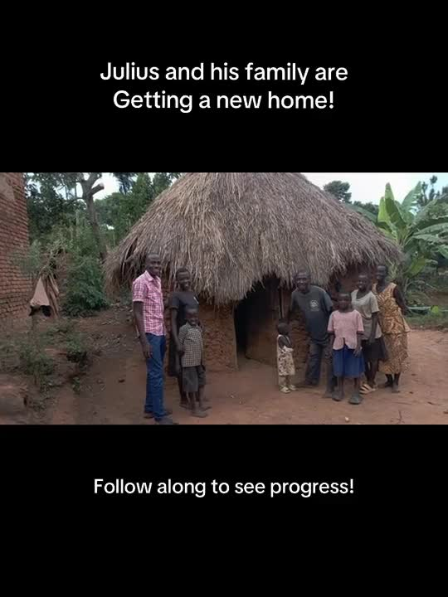

Slide 18
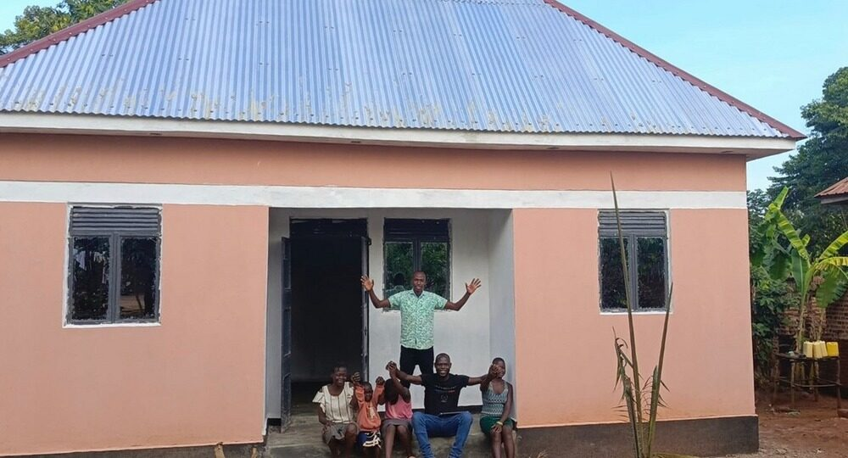
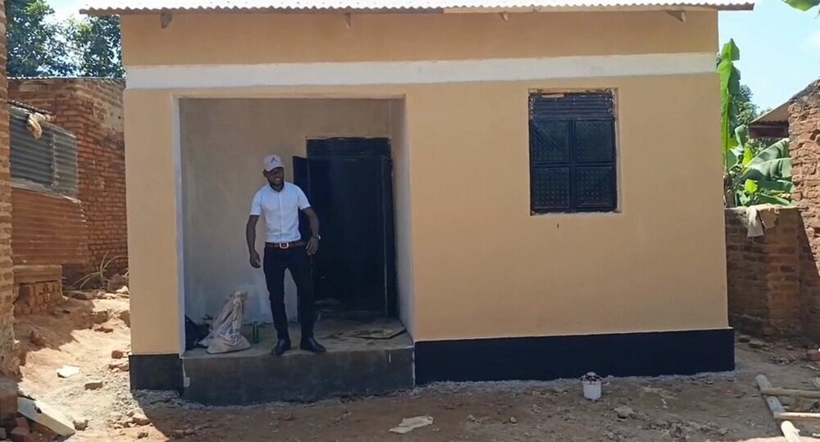
Two houses
Mary Auma and her children
about 380 square feet
Julius and his family
about 530 square feet
$7,584 for both.
Two families out of mud houses, into houses they own.

Slide 19
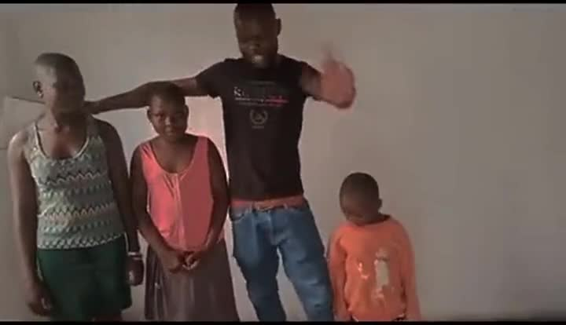

Slide 20
“We have put the spring of water
amidst the wilderness.
Our village is seeing the school
as a prayer answered.”
Pastor Isaac Muwewesi

Slide 21
$20 a month.
A child’s meals. Their education. A birthday gift.
29 children are still waiting for a sponsor.
Their faces are on the boards.

Slide 22
He Is Worthy
heisworthy.net
Starkville, Mississippi · a registered 501(c)(3) · gifts are tax deductible

